Slide 1

BUILDING A PRESENTATION WITH THE WAWANDCO STYLE
Nicole Escobar
Wawandco Designer
2018

Slide 2

Content
Headlines
1
Content
2
Big Statements
3
Quotes
4
Code
5
Blanks
6
Must-Haves
7

Slide 3

HEADLINES
Nicole Escobar
Wawandco Designer
2018

Slide 4
HEADLINES
Nicole Escobar
Wawandco Designer
2018

Slide 5


HEADLINES WITH BACKGROUND
Nicole Escobar
Wawandco Designer
2018

Slide 6
CONTENT

Slide 7
Wawandco’s Values
Initiative
Unity
Self-Discipline
Courage
Respect
Vision
Creativity
Responsibility
Excellence
Curiosity
Simplicity
Honesty

Slide 8
Types & Methods
You can define methods on any type that aren’t yours
Each language feature should be easy to understand.
type MyFloat float64 func (m MyFloat) Abs() float64 { f := float64(m) if f < 0 { return -f } return f } f := MyFloat(-42) f.Abs() // == 42.0

Slide 9
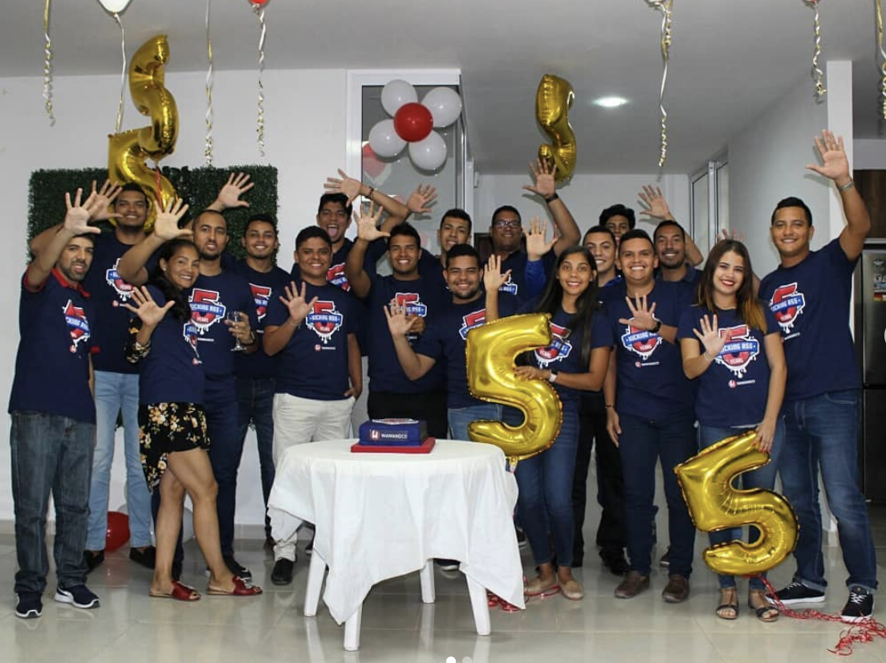

Wawandco Team
We are fans of the family

Slide 10
Wawandco Team
We are fans of the family But I must explain to you how all this mistaken idea of denouncing pleasure and praising pain was born and I will give you a complete account of the system, and expound the actual teachings of the great explorer of the truth, the master-builder of human happiness. No one rejects, dislikes, or avoids pleasure itself

Slide 11
Wawandco Team
We are fans of the family But I must explain to you how all this mistaken idea of denouncing pleasure and praising pain was born and I will give you a complete account of the system, and expound the actual teachings of the great explorer of the truth, the master-builder of human happiness. No one rejects, dislikes, or avoids pleasure itself

Slide 12
BIG STATEMENTS

Slide 13


Wawandco designs, develops and grows world-class web and mobile applications, with elegant and simple means.
What is Wawandco?

Slide 14
QUOTES

Slide 15
“
To know that we know what we know, and to know that we do not know what we do not know, that is true knowledge.
Nicolaus Copernicus (1473-1543)

Slide 16
CODE

Slide 17
Types and Methods
func PrintAbs(a Abser) { fmt.Printf("Absolute value: %.2f\n", a.Abs()) } PrintAbs(MyFloat(-10)) PrintAbs(Point{3, 4})
Types implement interfaces implicitly. There is no “implements” declaration.

Slide 18
Types and Methods
func PrintAbs(a Abser) { fmt.Printf("Absolute value: %.2f\n", a.Abs()) } PrintAbs(MyFloat(-10)) PrintAbs(Point{3, 4})
Interfaces specify behaviors. An interface type defines a set of methods:
func PrintAbs(a Abser) {
fmt.Printf("Absolute value: %.2f\n", a.Abs())
}
PrintAbs(MyFloat(-10))
PrintAbs(Point{3, 4})
A type that implements those methods implements the interface:
Types implement interfaces implicitly. There is no “implements” declaration.

Slide 19
BLANKS

Slide 20


Slide 22
MUST-HAVES

Slide 23
Recommendations
To build a great presentation, We recommend you to:
Use Airbnb Cereal font
Use Illustrations from Undraw , download it as .SVG with the color #FE4444
Use linear icons from Flaticon
Use Photos from unSplash

Slide 24







THANKS!
Your time is gold, thank you very much for giving us your attention.
Visit our site
wawand.co
Follow us on our social media
@wawandco
/wawandco
@wawand.co
Proudly Colombians

